Slide 1
Pitch deck

Slide 2
1. Company overview

Slide 3
About us
CBL One transforms university lecture slides into custom-made, case-based learning experiences, reducing faculty workload while boosting student engagement. We redesign existing content into interactive, patient-centric scenarios, enhancing critical thinking and retention. As the first comprehensive solution integrating CBL into existing materials, we empower universities to deliver modern, effective education—seamlessly.

Slide 4
2.Product overview

Slide 5
Problem
Market gap: After conducting an exhaustive market analysis, we found that our solution is uniquely positioned as the only product to integrate case-based learning as a core foundation, enabling students to apply knowledge in practical clinical scenarios.
Customers: following the success and popularity of ChatGPT, universities and educators are now actively seeking ways to leverage AI and increase awareness about these tools
Costs: University professors are often burdened with the time-intensive task of developing educational content, which can divert their attention away from high-touch, high-value activities such as mentoring students and providing personalized instruction. By alleviating this administrative burden, professors can redirect their time and expertise towards more impactful and interactive teaching methods, ultimately enhancing the learning experience for their students.

Slide 6
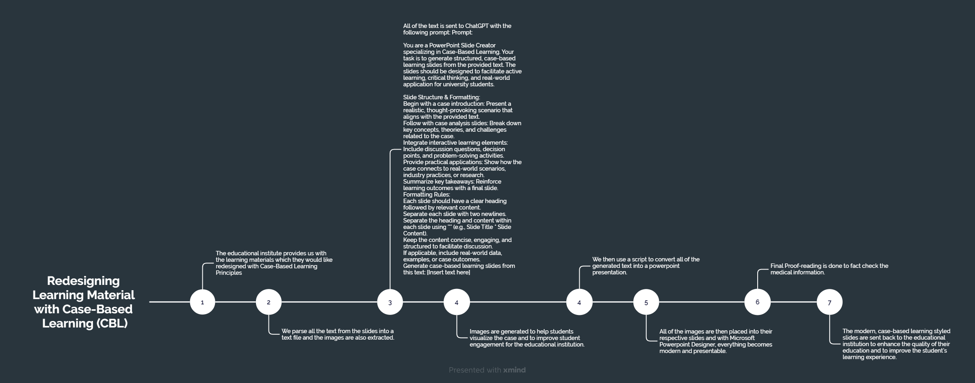
Our solution
All Python scripts and samples are available at https://github.com/cbl-one/MVP

Slide 7
Differentiating factors
Unique
First to market
Tested
Firsthand Experience
Only product specifically dedicated to creating resources with case-based learning as a foundation
Conducted testing with high school and college students in the area
Designed in line with the challenges faced during the implementations of problem and case-based learning

Slide 8

why we are applying to the Microsoft for startups program
Instant access to Azure Cloud which includes the products that our business will be based on:
Azure Functions: we hope to use them to automate our python scripts.
Access to a huge AI infrastructure with the ability to use ChatGPT for text generation and transformation, and DALLE for image generation.
Access to experts in the fields of Startups and Artificial Intelligence

Slide 9

Thank you
Muhammad Saqib Hussain
0036 20 482 0275
msh@mailbox.unideb.hu
https://cbl.one/

